Slide 1
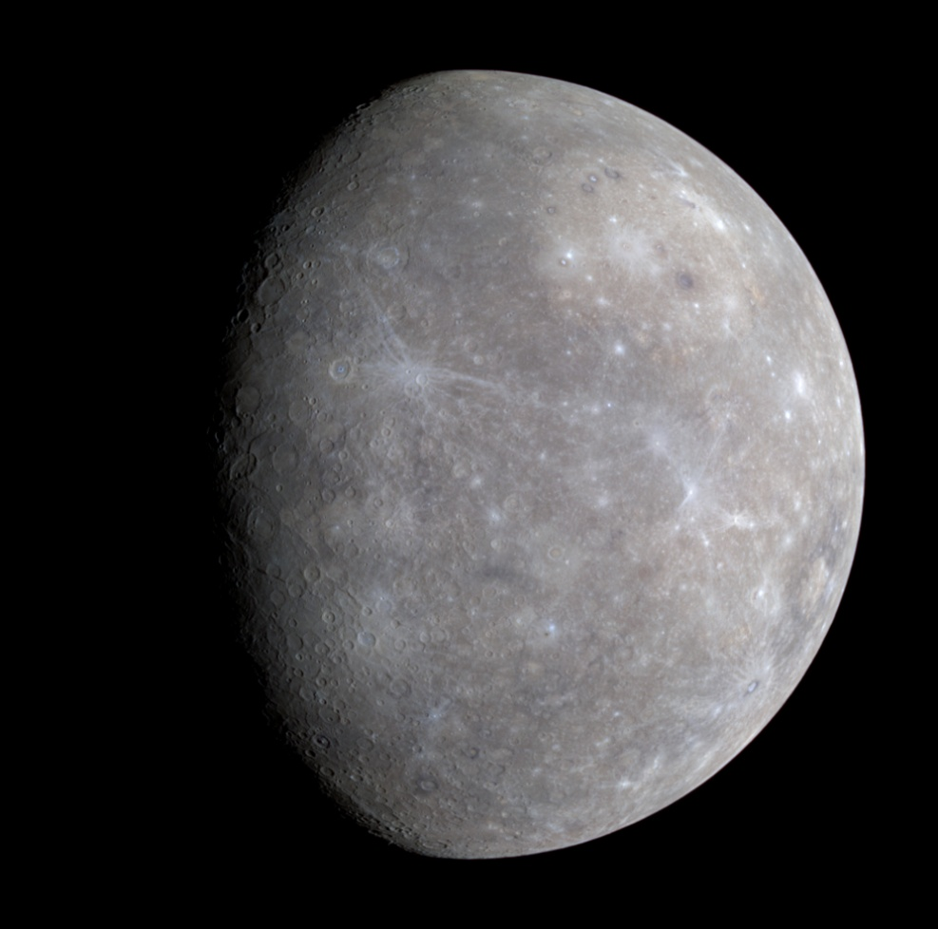
Particle Tracking in Mercury’s Magnetosphere
Albert Ryou
Brian Walsh
Notes:
Hi, my name is Albert. This summer I worked with Dr. Walsh on developing a computational model for simulating particle motion in Mercury’s magnetosphere. You may be asking, Why Mercury?

Slide 2
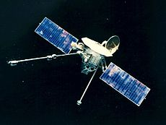
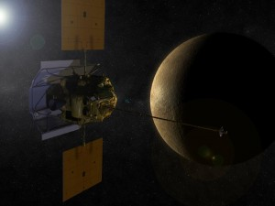
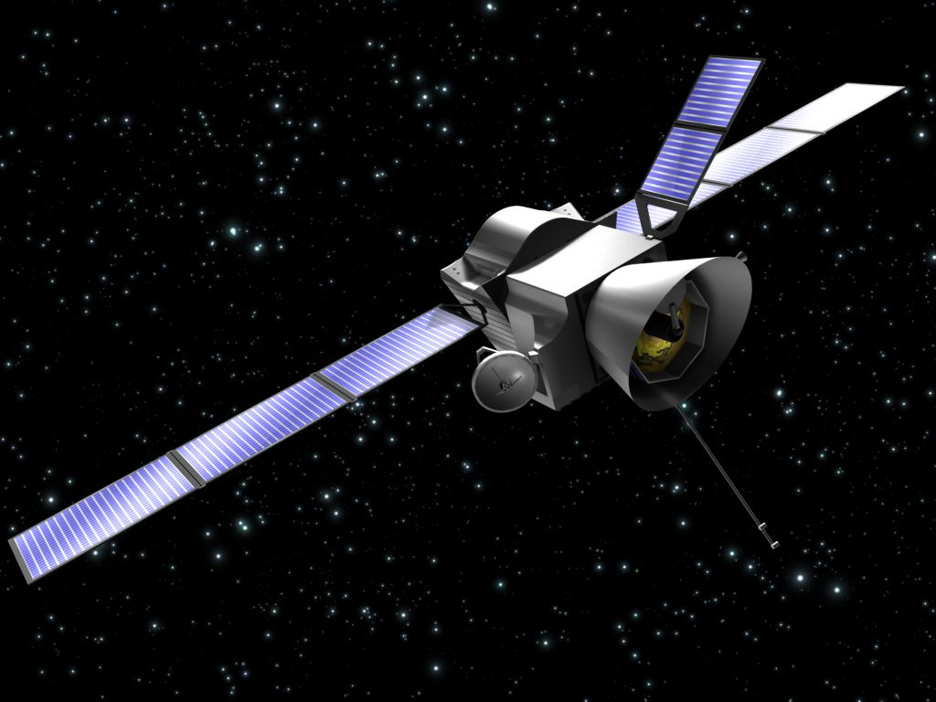
Missions to Mercury
Mariner 10, 1974-5
MESSENGER, 2008-present
BepiColombo, 2018
Notes:
Past and current missions to Mercury have found that Mercury has a magnetic field, just like the Earth. Neither Venus nor Mars has a magnetic field. In addition to the magnetic field, Mariner 10 in 1974 and MESSENGER thirty years later found electrons near the planet. The study of electrons in Mercury’s magnetic field forms the basis of my project. Another satellite, called BepiColumbo, is a joint project between Europe and Japan set to orbit Mercury beginning in 2018.

Slide 3
Objective: What can we learn about the electrons around Mercury from kinetic particle modeling?
1. Magnetosphere
2. Particle motion
3. Particle tracking simulation
Notes:
So here’s the objective: What can we learn about the electrons around Mercury from kinetic particle modeling? Can we corroborate using a model some of the phenomena seen by the satellites? Before I talk about the simulation, I will first talk about what Mercury’s magnetic field looks like. Then I will mention briefly the general kinds of motion that we can expect the electrons will in the magnetic field. Finally, I will talk model development and results.

Slide 4
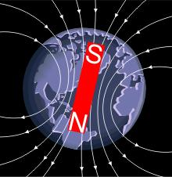
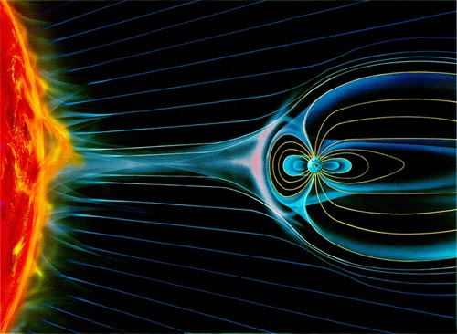
1. The Magnetosphere
Intrinsic Magnetic Field
Solar Wind
Notes:
First, the magnetic field. If we take a look at the Earth, it has an intrinsic magnetic field that looks like a dipole. The Earth is also at the same time being constantly bombarded by a stream of solar particles called the solar wind, which the intrinsic field deflects around the planet. Planetary magnetic fields, together with the solar wind from the sun, form what are known as magnetospheres.

Slide 5
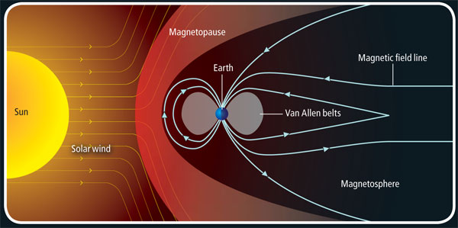
cusp
magnetotail
Notes:
In this closer view of the magnetosphere, we can label some parts. The boundary between the solar wind and the planet’s intrinsic magnetic field is called the magnetopause. The areas near the poles where the field lines come in and out of the planet are called cusps. The field facing away from the sun form a long tail is called the magnetotail.
*Point to labels

Slide 6
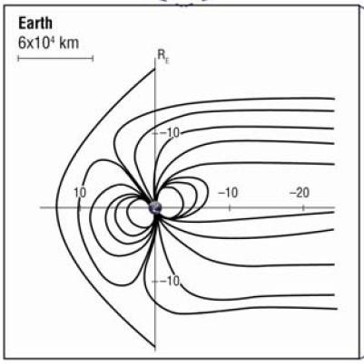
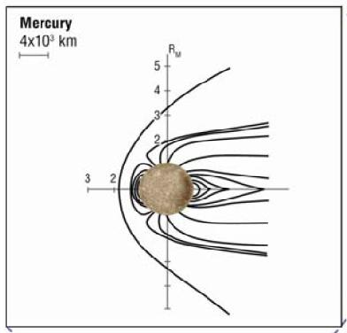
Mercury has a magnetosphere too!
Notes:
Mercury has a magnetosphere too. As you can see from the scales in the plots showing Earth on the left and Mercury on the right, Mercury’s magnetosphere is very small; it extends to about one and a half Mercury radii.

Slide 7
2. Particle Motion
Lorentz Force
Gyro motion
Bounce motion
Drift motion
Notes:
Now, for particle motion. The Lorentz force determines how a charged particle will move in space. To see where it is going, all we have to do is to provide a value of the electric field and a value of the magnetic field, and then track the particle as time progresses. On the other hand, if we know what the fields look like beforehand, we can anticipate certain patterns of motion. The Lorentz force gives rise to three patterns for an electron: gyro motion, bounce motion, and drift motion.

Slide 8
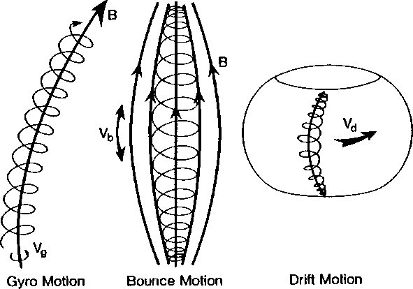
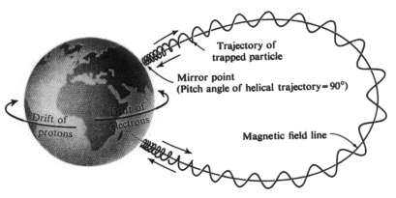
Notes:
Gyro motion makes the electron orbit around a magnetic field line. Bounce motion pushes the electron back and force along the field line. Drift motion makes the electron go around Mercury.

Slide 9
3. Simulation
Lorentz force again
Numerical integration with Runga-Kutta
Can vary starting position, energy, pitch angle
Assumptions
No gravity
E = 0
Static B field
Collision-free motion
Notes:
Now for simulation. Again the three patterns I just talked about all arise from the Lorentz force, so
For the simulation, we used the Lorentz force and the static Alexeev magnetic field model to find the electron location at each time step. The numerical integration was done using the Runga-Kutta method. For a typical run, we would first specify the starting position, energy, and pitch angle of an electron and then track the particle for one minute of electron time.
The assumptions used for this kinetic model were
No gravity. Electrons are so light that almost all dynamics comes from the electromagnetic force.
Zero electric field. Energetic particles are dominated by gyro, bounce, and drift motion, and the effect of the E x B drift is minimal.
3) Static magnetic field. For our model, we use the Alexeeve magnetic field, which is a static field
4) Collision-free motion. We assume a large mean free path so multiple electrons do not influence one another.

Slide 10
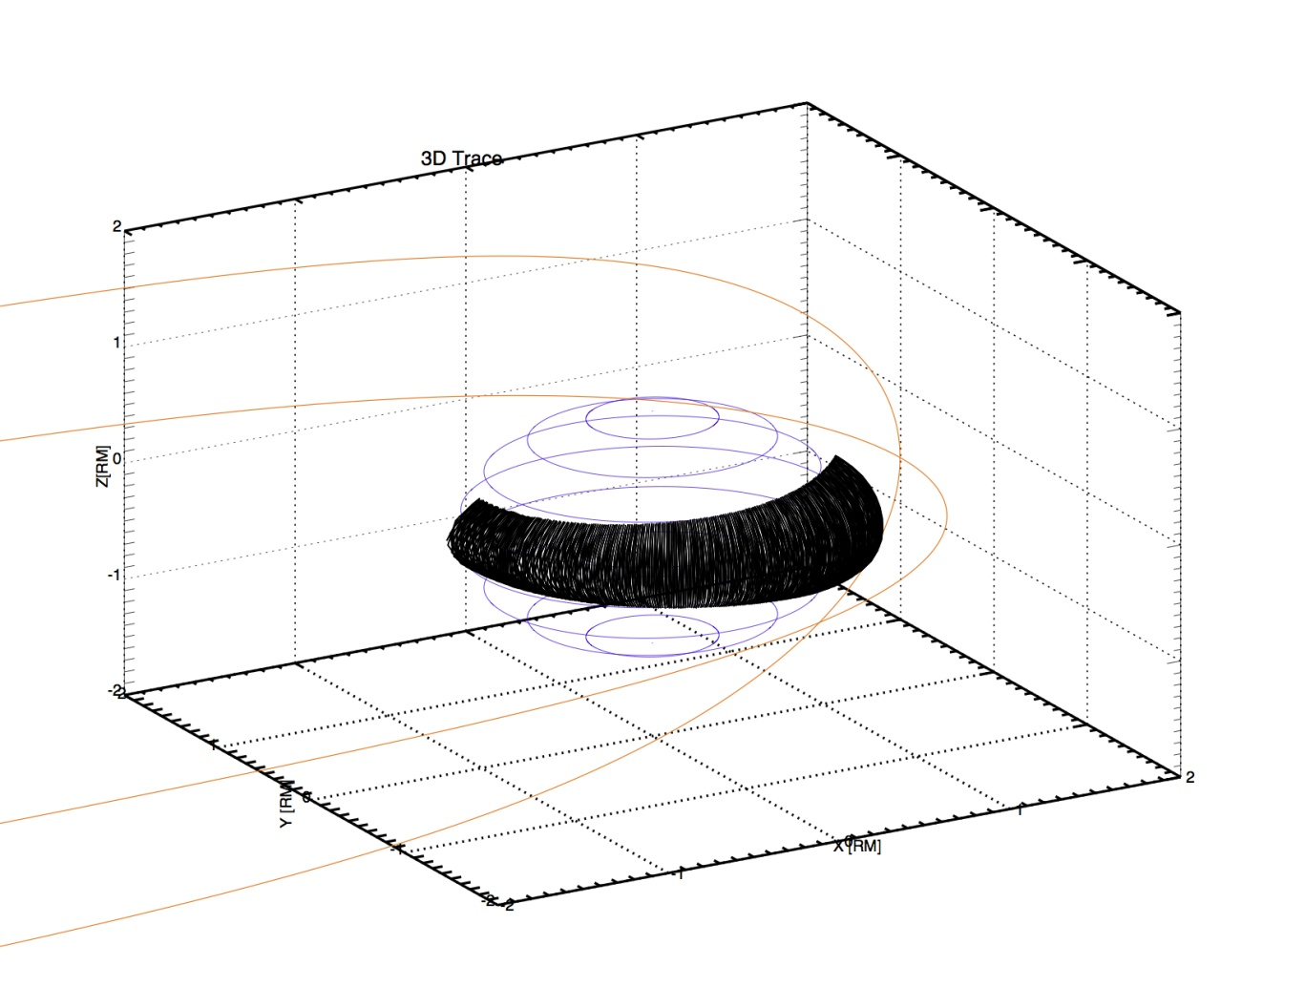
Collide with the planet
Notes:
10 degrees, zoom in, put in initial conditions
Just describe yellow lines, sun position, geometry
Three things

Slide 11
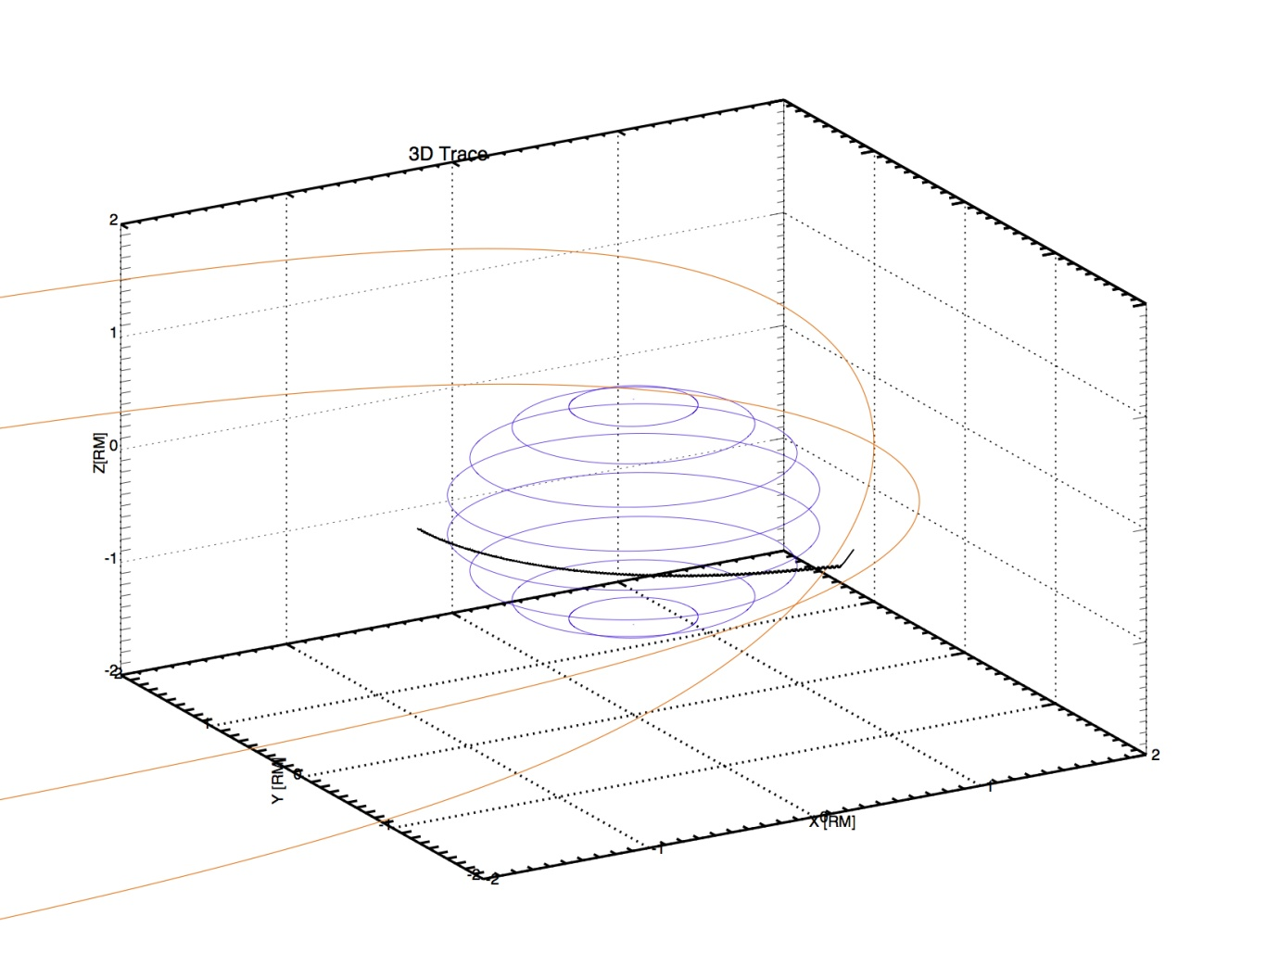
Escape into the magnetopause
Notes:
Explain what happens at/after magnetopause

Slide 12
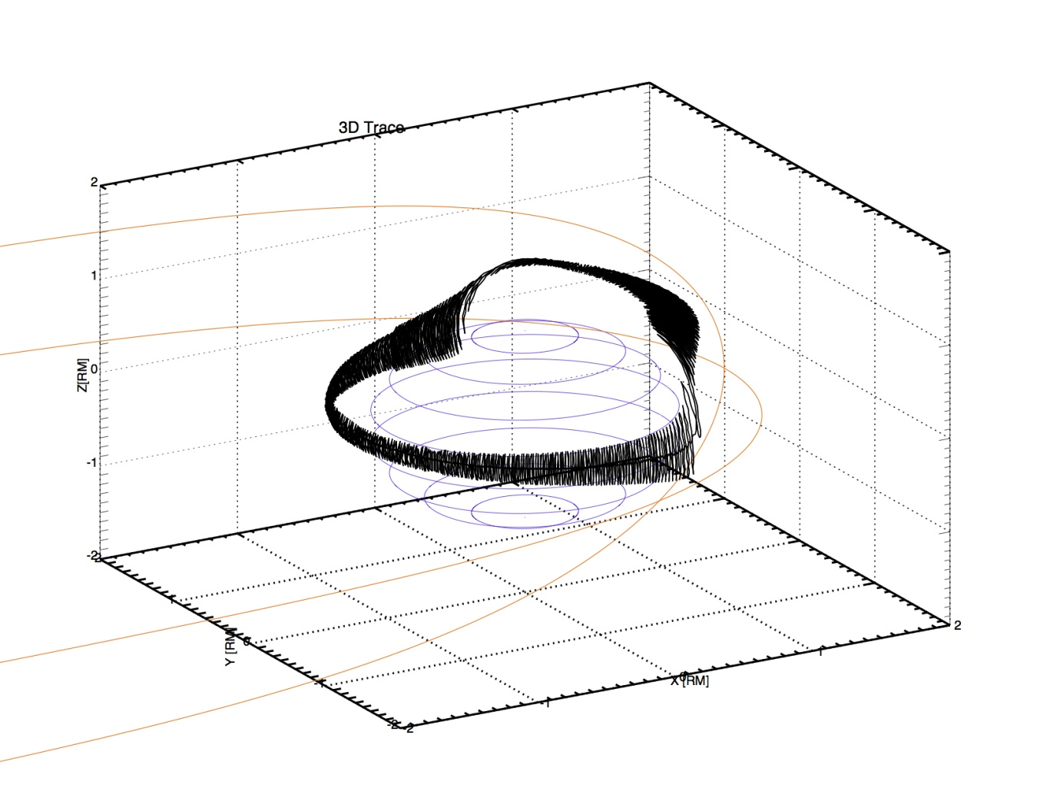
Trapped

Slide 13
Single particle

Slide 14
Multiple particles (2730)
Notes:
Parallel coding here?

Slide 15
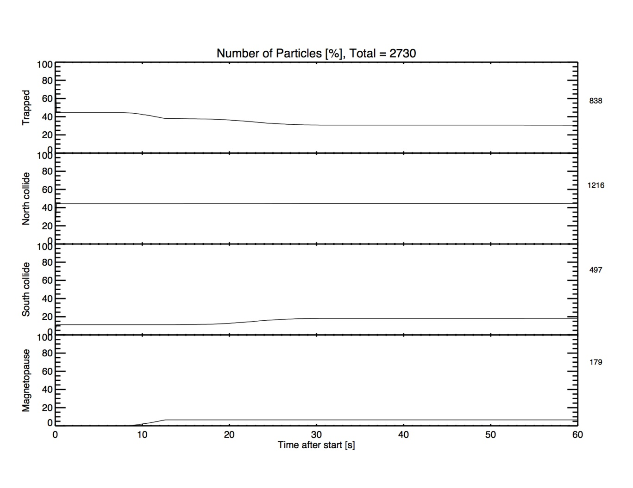
How many trapped

Slide 16
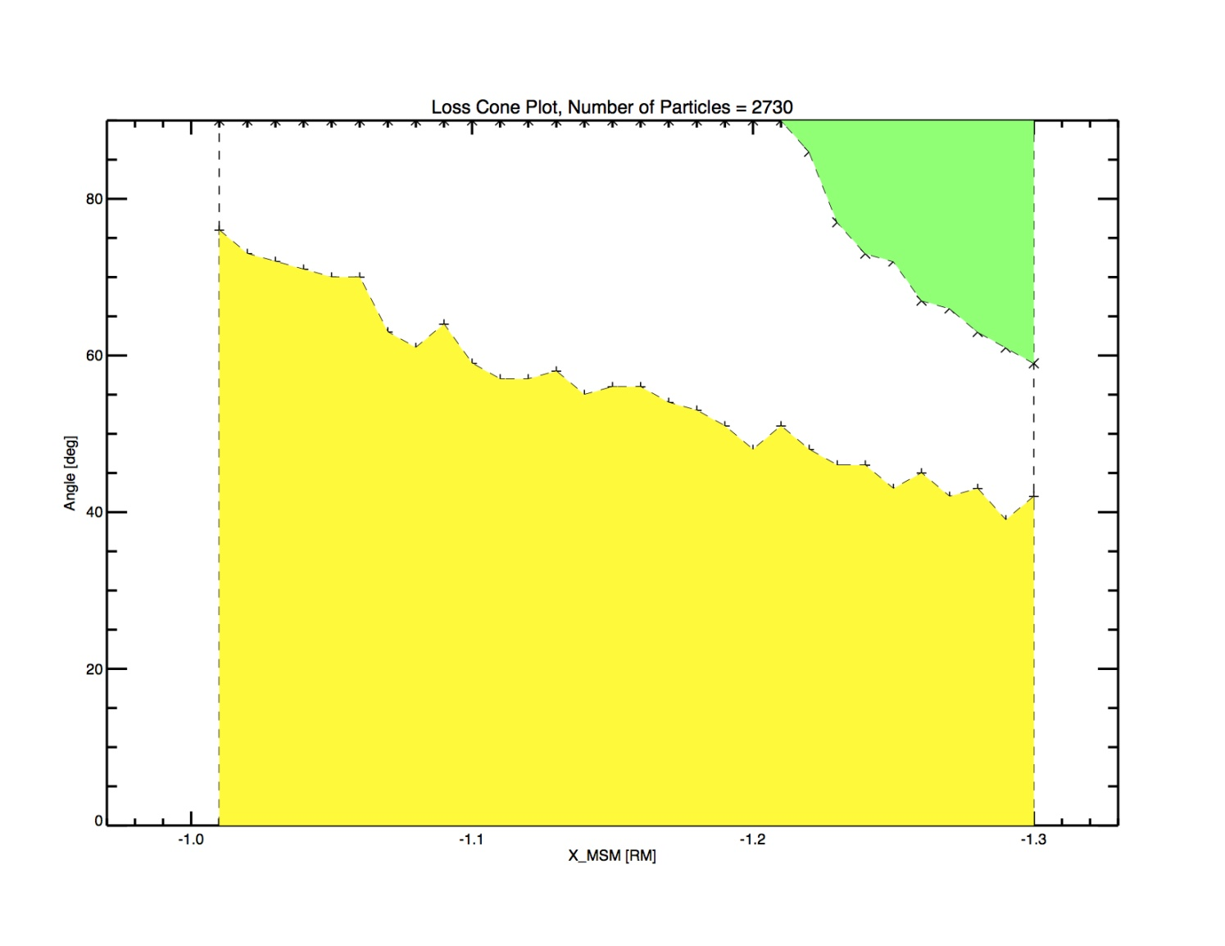
Loss cone
Magnetopause
Trapped
Collision with Planet

Slide 17
Comparison with Mariner 10
Observation: Mariner saw bursts of energetic particles with a period of 6 to 10 seconds.
Explanations:
Theory 1: A series of substorms every 6 to 10 seconds cause electron bursts [ekhert et 1976]
Theory 2: A single substorm causes drift resonance – electrons orbit around Mercury once every 6 to 10 seconds.
Simulation: trapped 50-keV electrons have a period of about 30 seconds – rules out Baker.
Notes:
Call out

Slide 18
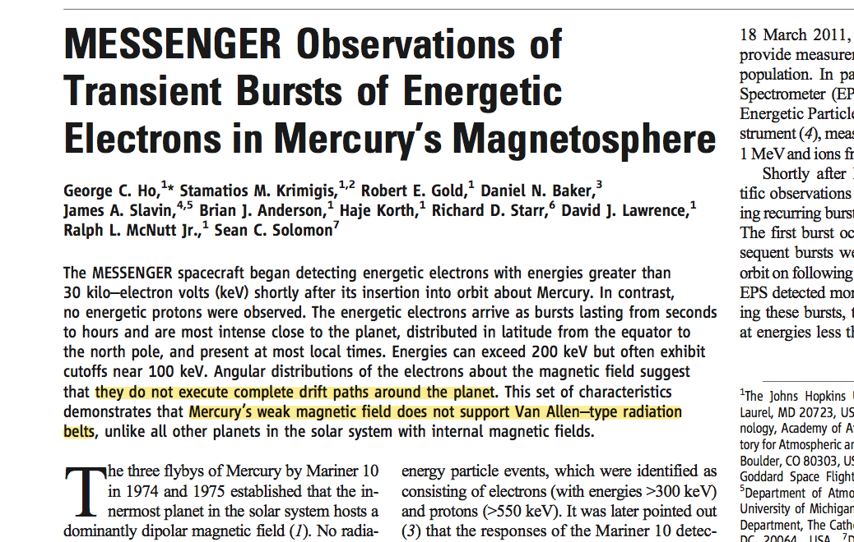
Comparison with MESSENGER
Notes:
After this slide, show the observation and the trace either and say its consistent with the orbiting population
Peak at 90 at the equator, consistent 1) high latitude, 2) peack at 90 at nightside
Although the paper by ho et al sates that it’s unlikely, a number of the observations are consistent with a trapped population shown by the simulation.

Slide 19
Conclusion
Developed a computational model to trace particles in a model magnetic field.
Expanded and parallelized the code to incorporate a range of initial conditions.
The results were consistent with observations by Mariner and Messenger that implied an existence of a trapped electron population.

